Slide 1


Slide 2
85%
Nick Heudecker‏ (Gartner analyst)

Slide 3
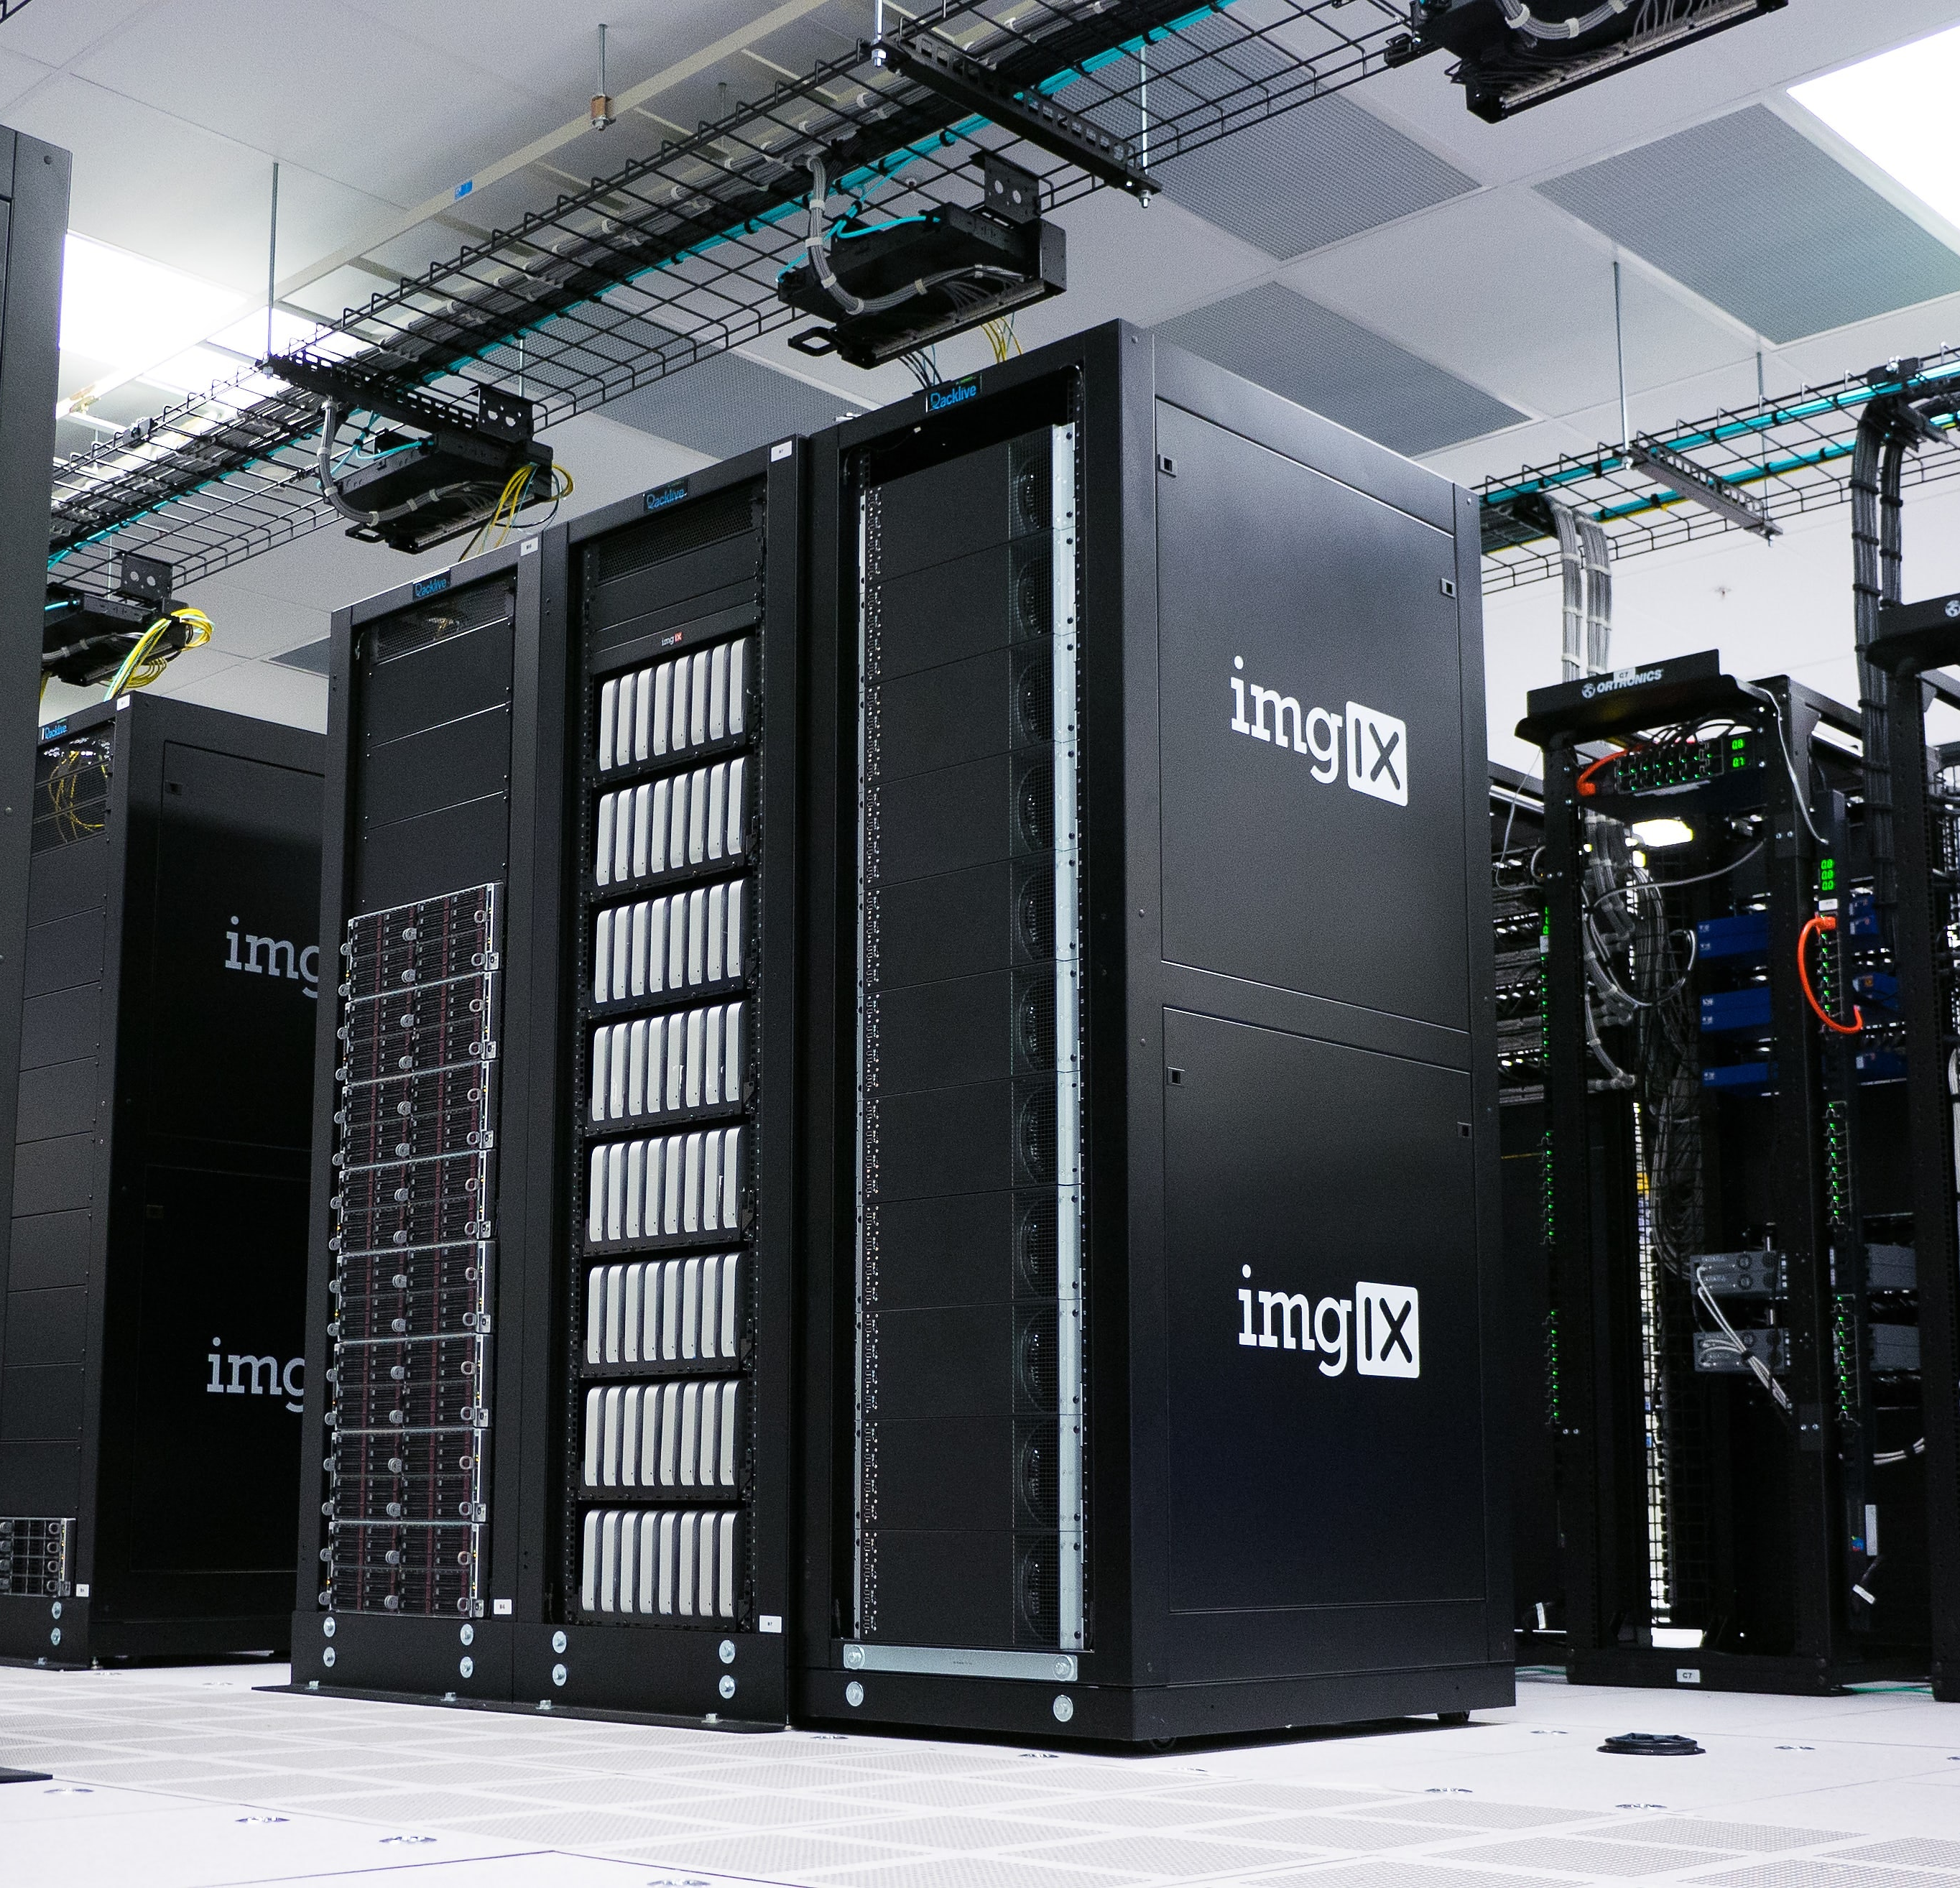


Slide 4
Getting your R project into production using Databricks

Slide 5

What we will talk about
Data science lifecycle
Spark and R
Databricks

Slide 6
Data Science Lifecycle
Notes:
CRISP-DM
Team Data Science Process

Slide 7
Problem
Problem
Acquire Data
Model
Deployment

Slide 8


Slide 9


MapReduce
2004
2003
Google File System (GFS)
Predecessor to HDFS
History of Azure Databricks

Slide 10


MapReduce
Spark
2004
2012
2003
2006
Google File System (GFS)
Apache Hadoop Project
Predecessor to HDFS
History of Azure Databricks

Slide 11




DataFrames API / SQL
Streaming
Graph
Machine Learning

Slide 12
MapReduce
Spark
2004
2012
2003
2006
2013
Google File System (GFS)
Apache Hadoop Project
Databricks
Predecessor to HDFS
History of Azure Databricks

Slide 13
Architecture
Notes:
CRISP-DM
Team Data Science Process

Slide 14
Resilient Distributed Datasets
Directed Acyclic Graph

Slide 15
Resilient Distributed Datasets
Directed Acyclic Graph

Slide 16
Language APIs
Java, Scala, Python
SparkR
ML Pipelines
Spark ML
Analysis APIs
SQL
Dataframes
Datasets
ML lib
Spark SQL
Streaming
Graph
Resilient Distributed Datasets (RDDs)
Core API
Spark Core
https://databricks.com/blog/2016/12/28/10-things-i-wish-i-knew-before-using-apache-sparkr.html

Slide 17
Worker
Executor
Driver
Worker
Cluster Manager
Data sources
Spark Context
Executor
Worker
Executor

Slide 18
Data bricks

Slide 19


Implementation

Slide 20



One environment for The whole team

Slide 21

One click setup

Slide 22

Scale

Slide 23

Security

Slide 24
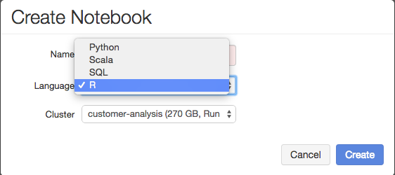
Interactive Notebooks

Slide 25

R Studio integration

